Slide 1
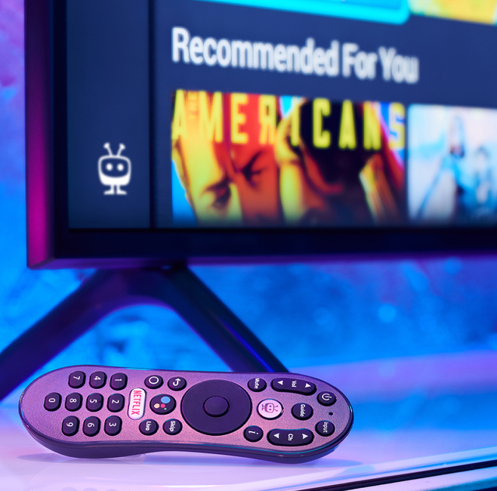


Slide 2
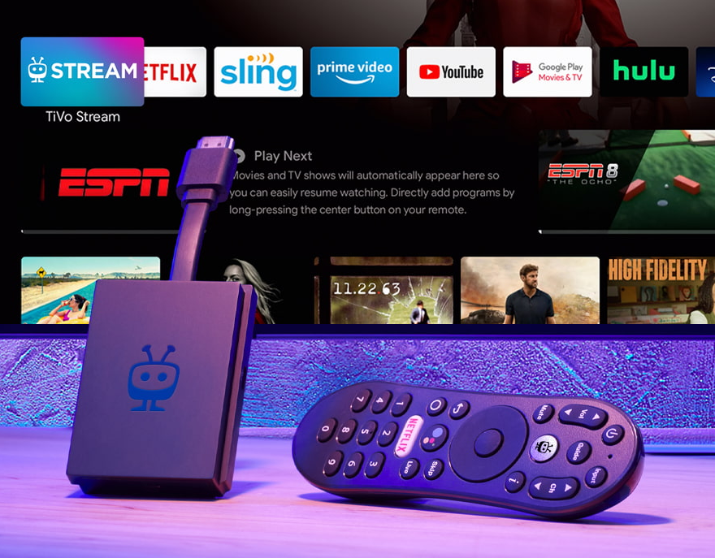
TiVo added value
TiVO intro
Since its inception, when TiVo began to redefine how people watch TV, TiVo has been know for its revolutionary user experience, and the remote control has been a central part of this UX. With unique features like the thumbs-up and thumbs-down buttons, and always with its instantly recognizable peanut-shaped remotes.
With its unique UX, TiVo has become a cornerstone of many operators’ TV offerings, as they’ve built their set-top boxes’ user interface around TiVo’s convenient interaction model.
A unified user experience

Slide 3
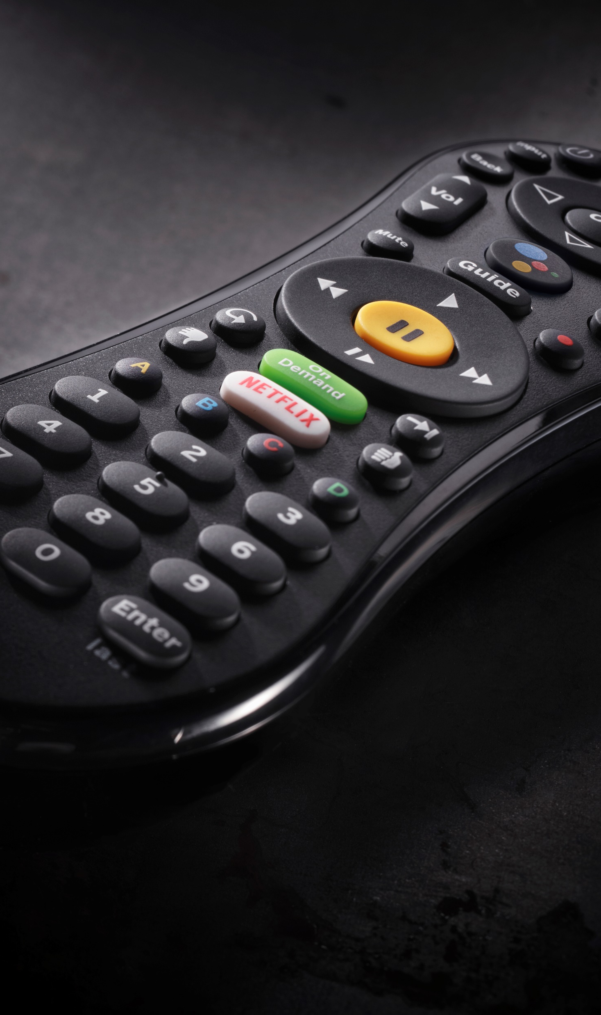
Why a TiVo remote from UEI?
Designed in conjunction with TiVo, the remotes are
fully certified to meet TiVo’s functional requirements.
All TiVo Remote Controls from UEI are designed for the iconic TiVo user experience. They closely follow the strict design guidelines that are integral to the famous TiVo UX. This includes remote shape, size, key layout, and key functions including:
  TiVo button
  Thumbs Up, Thumbs Down keys
  Peanut-shaped design with gripped waistline
  Setup Methods

Slide 4


Seamless control
Tivo Control solutions
QuickSet Cloud is the industry standard
for home control
Launched in 2008, QuickSet has been deployed in over 550M devices with over 100B transactions
Device and system knowledge base for discovery, control protocols, functions and system behavior
Control data for over 2.4 million unique fingerprints across nearly 1 million devices from 12,500 consumer brands, offering true interoperability between home entertainment and smart home devices and ecosystems
QuickSet Cloud architecture is built with control engines and discovery, automation and management frameworks with capability for IP, RF4CE, Zigbee, Bluetooth and Infrared
Detect, control and interact with virtually every device within the home using the largest knowledge graph of devices.

Slide 5

Simplifying the setup experience
Top three remote control
pain points
Setup confusion
How to program?
Input confusion
What input is my device on?
Don’t understand the remote
So many keys, what do they do?
Remote controls can be confusing

Slide 6
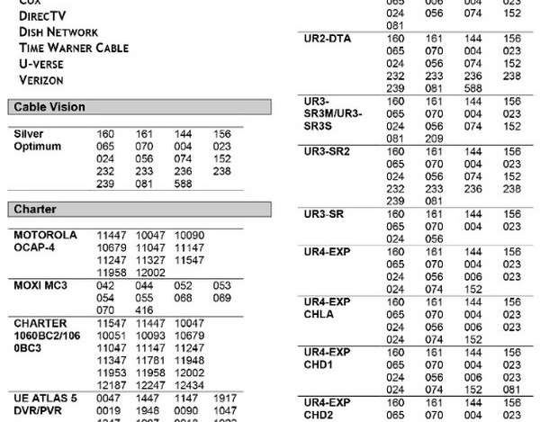

benefits for video service providers
  Traditional programming
  Programming methods
  4, 5 or 6 digit code lists: trial and error
  Success rate
  Time consuming to achieve 100% match if even
  Upgrade / reprogramming
  15% increase in service calls for reprogramming
Code entry is complicated

Slide 7
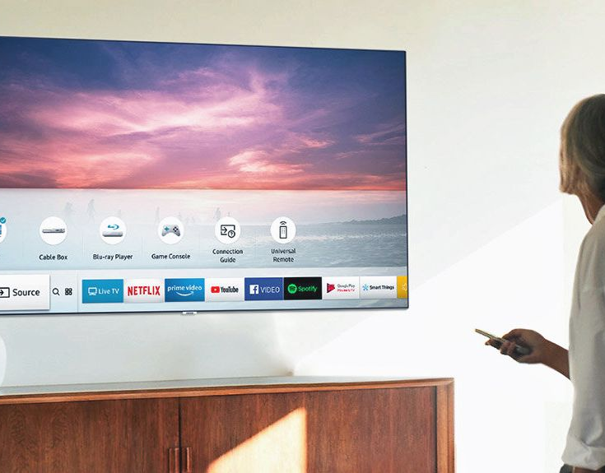
benefits for video service providers
  GUI-based programming
  Brand-based setup
User needs to select a brand on set-top-box GUI and then try if they work one by one.
  Model-based setup
User needs to select a brand and model number on set-top-box GUI and then try if they work.
  Automated setup (Unique to UEI)
QuickSet automatically discovers and pairs the box with the television; no intervention required.
QuickSet Cloud keeps adding new control protocols and codes and keep you up to date.
No more setup confusion as devices automatically work

Slide 8
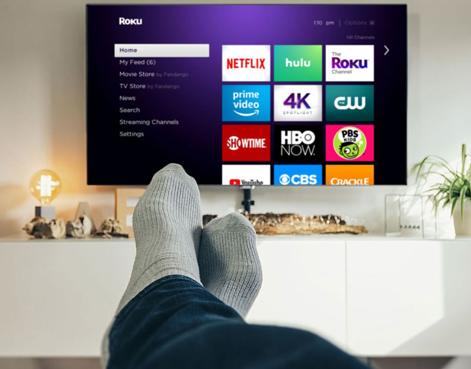
Simplifying the control experience
15% of TV users struggle with switching inputs
Streaming leads to more input switching
Many people watch streaming services on other device than their pay TV set-top box
Smart TV is most used platform for streaming video and growing
Gaming forces input switching
Game consoles are using other HDMI port; even in sleep mode, game consoles keep active input
Switching input creates confusion
Several major TV brands will not automatically select the latest active input of the set-top box; needs to be manually selected each time
Streaming and gaming creates input confusion

Slide 9
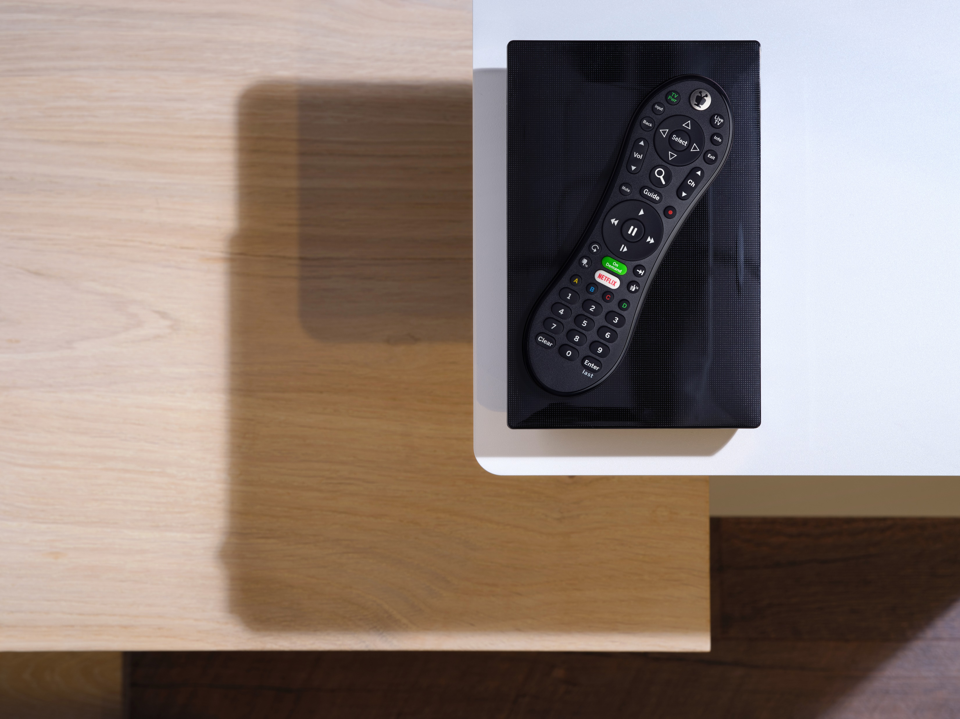
Simplifying the control experience
One Touch View
Single button to instantly get user to watching content
  Powers up required devices automatically
  Switches inputs on TV and AVR
Dynamic Key Mapping
  Remote keys map automatically to devices based on activity
    Volume goes to AV receiver
    Channel goes to STB
    Play/Pause goes to STB/DVR
    Input goes to TV
    Power goes to ALL
  Adaptive Control
  Shows only the keys you need
    Digit keys in Live TV mode
    Fast forward in Recorded Content mode
No more input confusion with One-Touch View

Slide 10
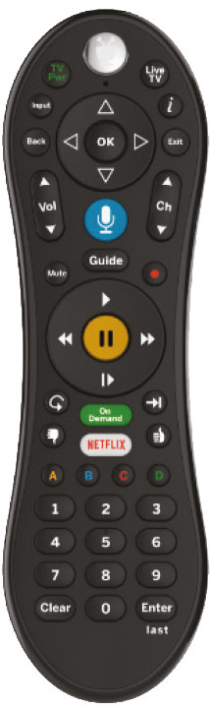





TiVo S6Z Voice Backlit
Video Service Providers – Standard Products
TiVo Remote Control
The TiVo S6ZBL Voice Remote features a dedicated Netflix button for easy access to Netflix content.
With integrated ZigBee™ RF4CE, the TiVo S6 Voice Backlit remote can control hidden RF-enabled set-top boxes including:
Pace MG1 Gateway
Pace Mi3 Client
Use verbal commands to search for content or to tune to any network using Universal’s proven reliable voice remote control architecture.
Backlight
Push to Talk
Voice
RF4CE
Control
IR
Control

Slide 11
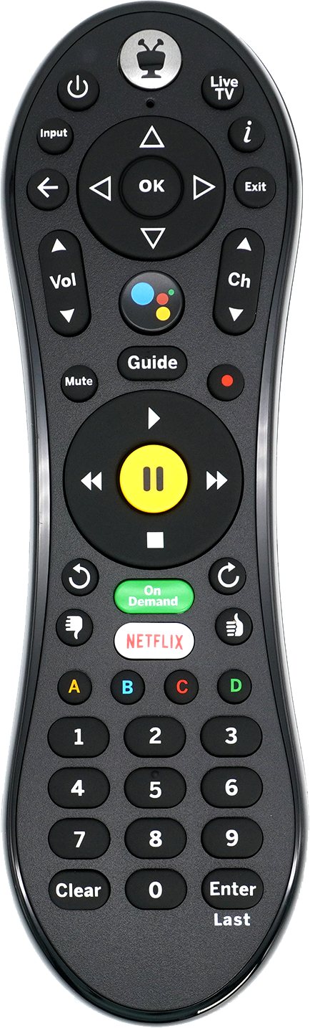


TiVo S6A Voice Backlit
Video Service Providers – Standard Products
TiVo Remote Control
The TiVo S6A Voice Remote is designed for the iconic TiVo user experience with the addition of voice search capabilities. It features a dedicated Netflix button for easy access to Netflix video content.
Using integrated Bluetooth LE®, the TiVo S6A Voice remote can control hidden BLE-enabled set-top boxes including:
Commscope VIP6102W
Evolution eStream 4K
Backlight
Push to Talk
Voice
BLE
Control
IR
Control

Slide 12
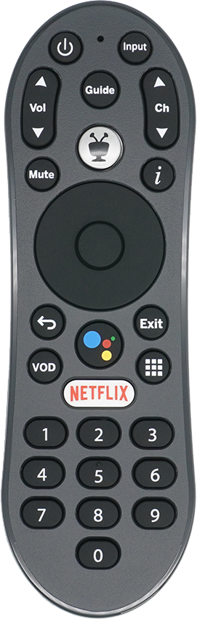
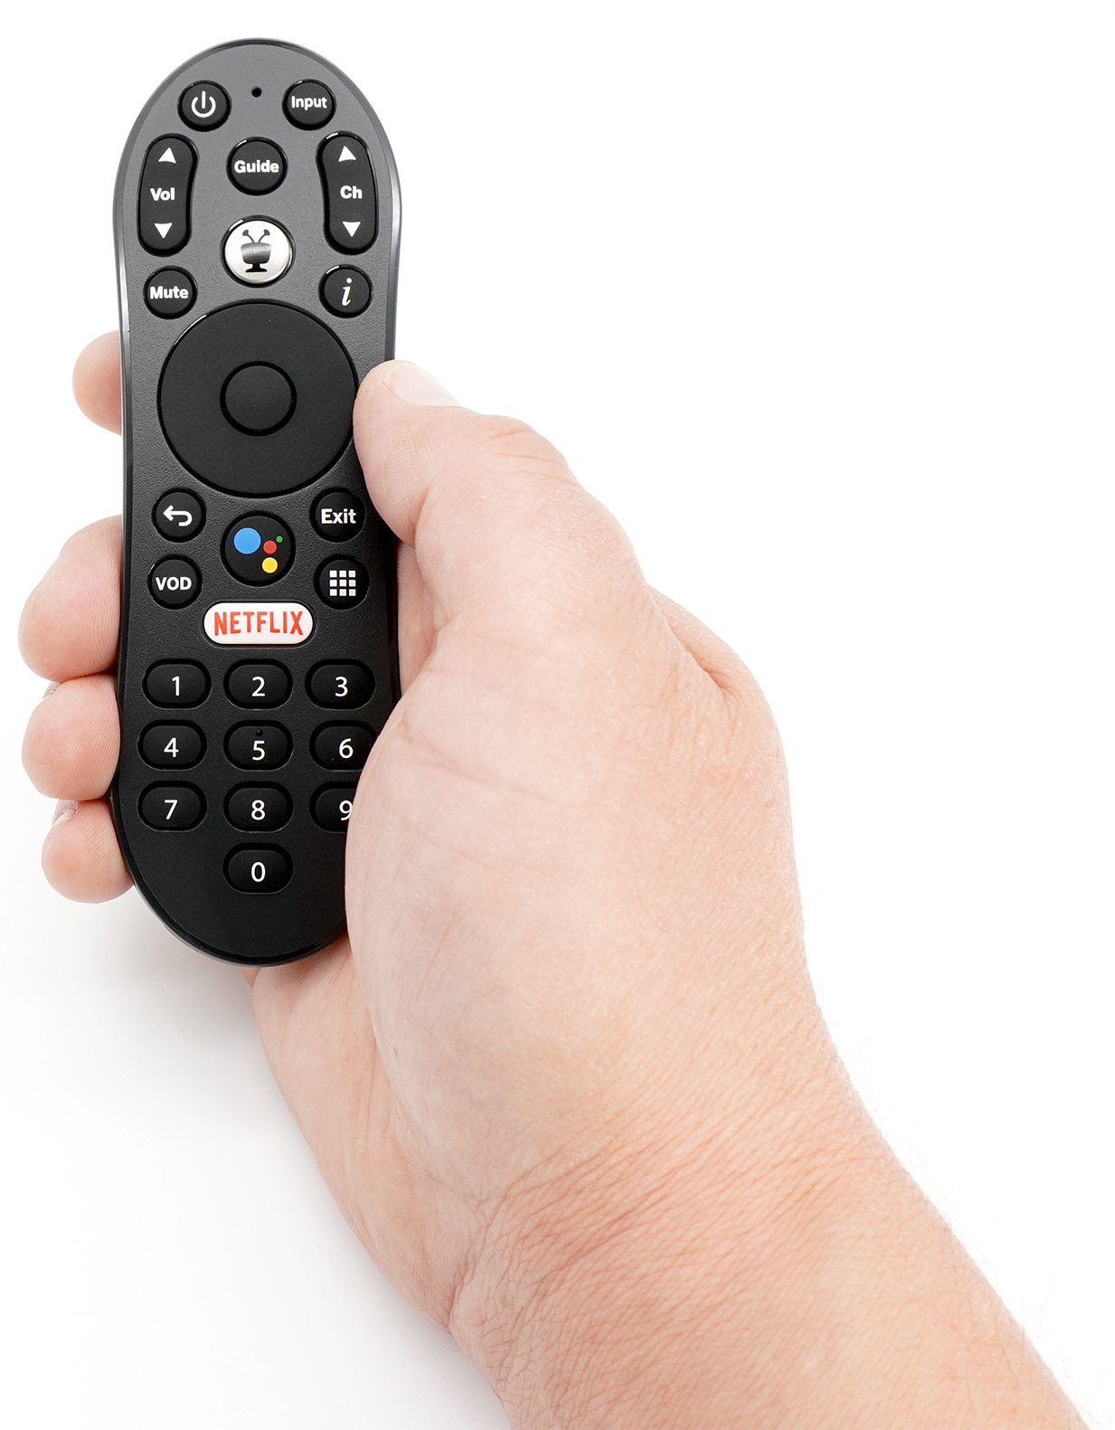

TiVo Stream 4K
Video Service Providers – Standard Products
TiVo Remote Control
The TiVo Stream 4K Remote is made for AndroidTV-based set-top boxes and dongles with TiVo functionality like the TiVo Stream 4K.
The compact remote control is designed utilizing the iconic TiVo user experience with the addition of various features such as voice search capabilities, dedicated Netflix button and more. The TiVo experience comes to Android TV with integrated voice over BLE, finding your desired content or favorite channel has never been easier.
The TiVo Stream 4K Remote comes with QuickSet integrated.
App Keys
Push to Talk
Voice
BLE
Control
IR
Control

Slide 13
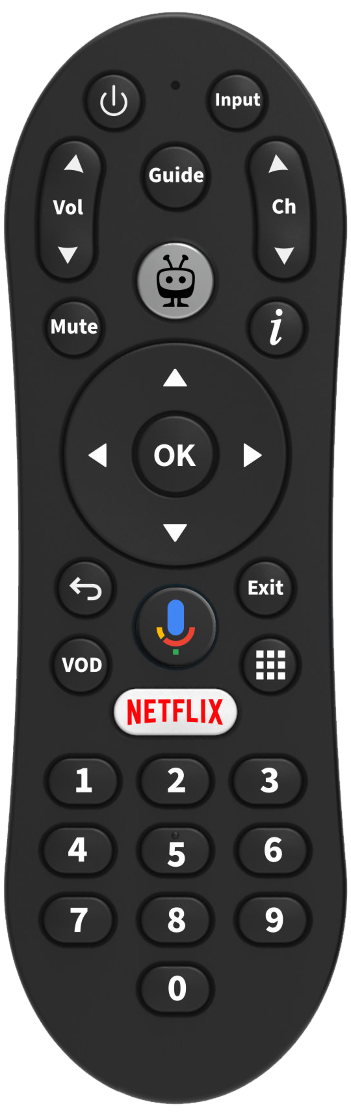
TiVo Stream 4K Lite
Video Service Providers – Standard Products
TiVo Remote Control
The TiVo Stream 4K Remote is made for AndroidTV-based set-top boxes and dongles with TiVo functionality like the TiVo Stream 4K.
The compact remote control is designed utilizing the iconic TiVo user experience with the addition of various features such as voice search capabilities, dedicated Netflix button and more. The TiVo experience comes to Android TV with integrated voice over BLE, finding your desired content or favorite channel has never been easier.
The TiVo Stream 4K Remote comes with QuickSet integrated.
App Keys
Push to Talk
Voice
BLE
Control
IR
Control

Slide 14
Thank you!

